Slide 1
Jet representation
Ten vertices with shortest displacement are extracted from each jet.
The data fields for each vertex are: vertex displacement, vertex multiplicity, and the magnitude of the vector sum of constituent PT.
For jets with n_vert<10 the missing entries are masked with -10.0.

Slide 2
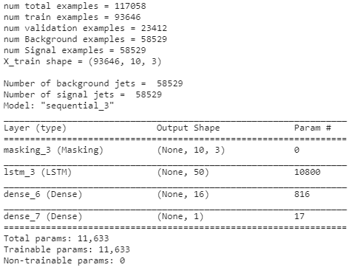
LSTM architecture and dataset size

Slide 3
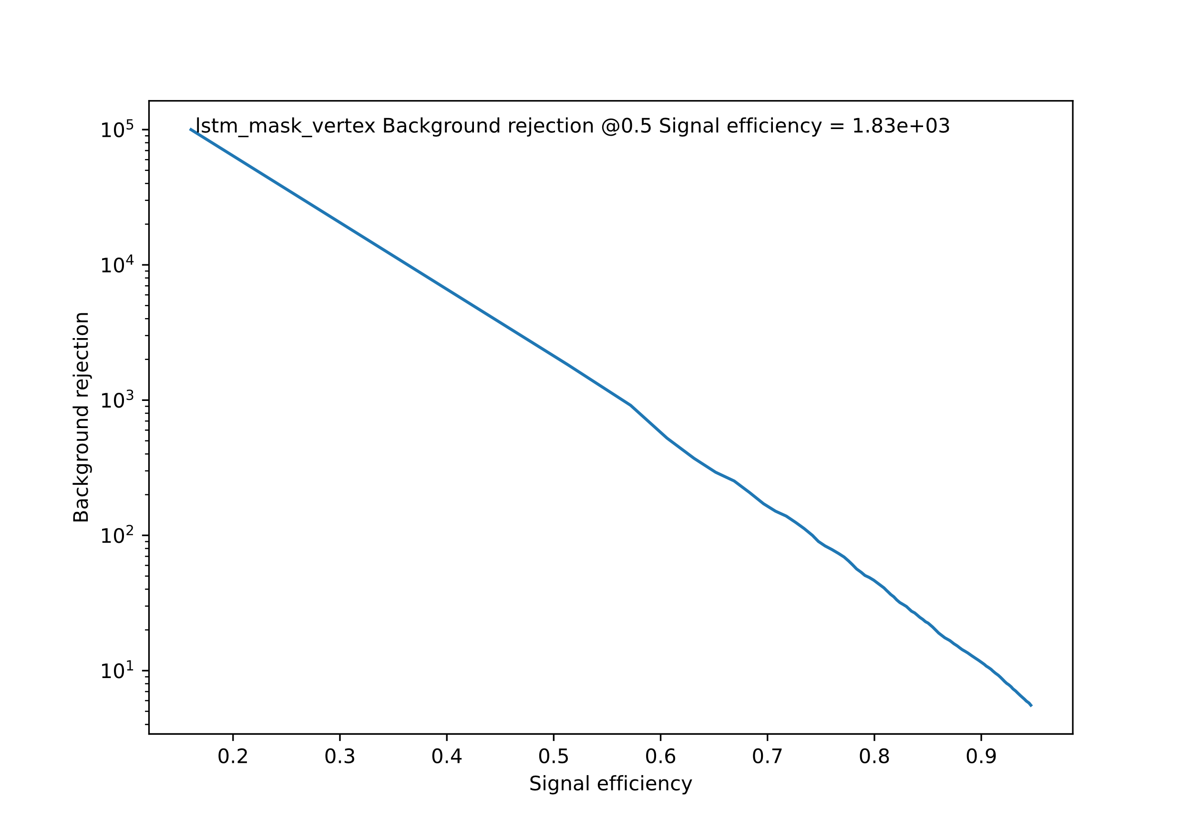
Results

